Slide 1
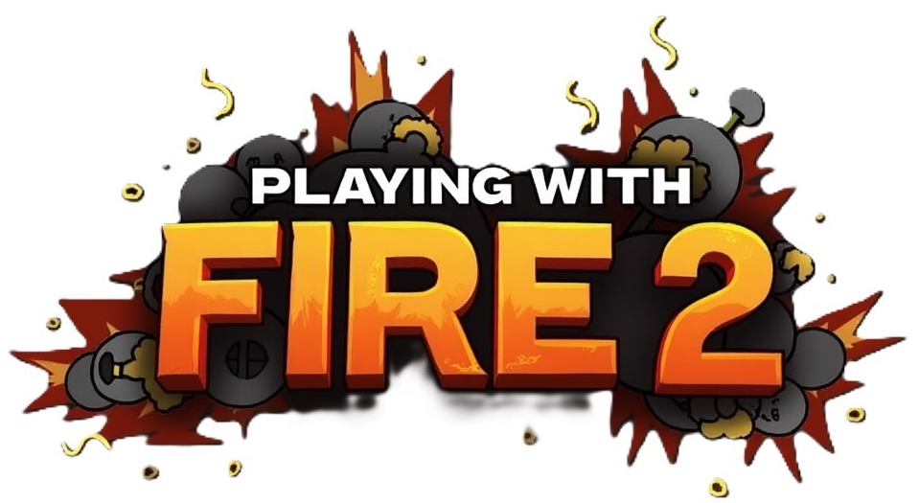
Concurrent and Distributed Programming
Dr. Yehuda Ben-Shimol
Mr Guy Perets
Authors – Dolev Eisenberg and Roi Alus
Git
Youtube

Slide 2
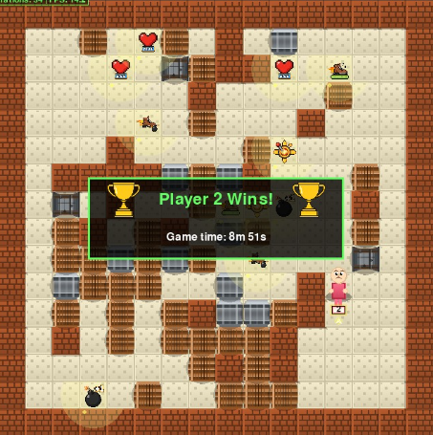
Multiplayer Arena Battle Game
Objective:
Be the last player standing! Navigate through a maze-like arena, strategically place bombs to destroy obstacles and eliminate opponents.
Each player starts with 3 lives, lose all your lives and you're out of the game.

Slide 3
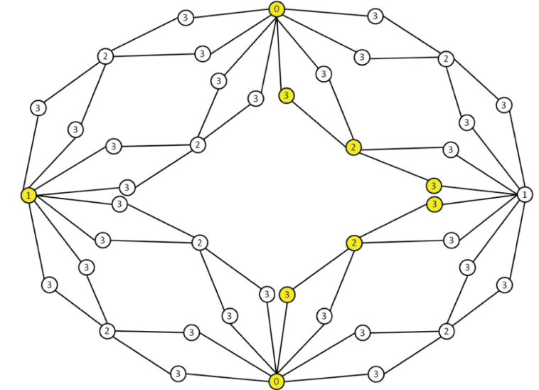



The Map
The map is generated by using Steiner Tree algorithm, making sure there is a way to get from one player to all others.
Tiles:
One-hit tiles
Two-hit tiles
Non-destructible walls

Slide 4
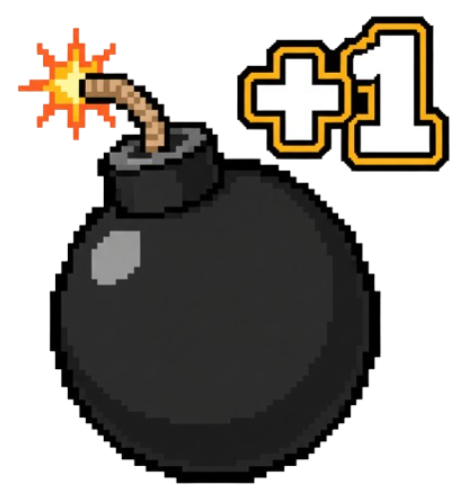


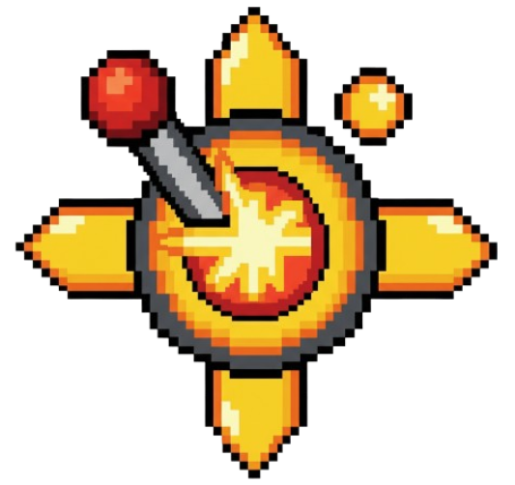
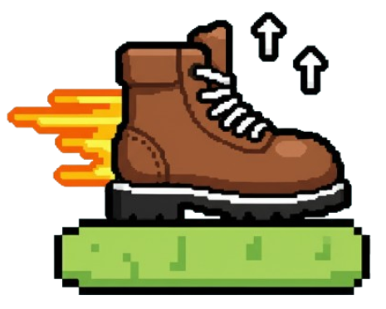
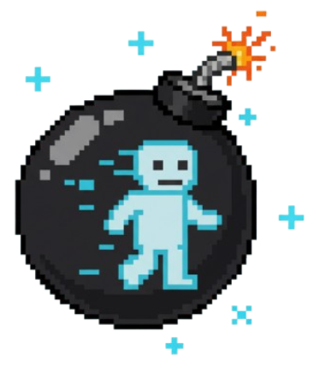
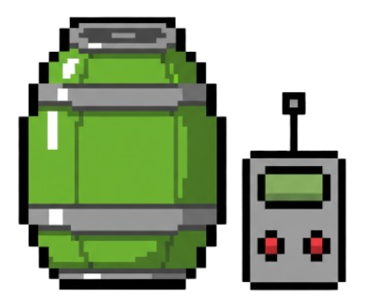
Power-Ups
Strategic power-ups spawn after tiles are destroyed to enhance your abilities:
Extra Bomb - Allows placing multiple bombs simultaneously
Extra Life - Adds one additional life point
Freeze Bomb - Delays bomb explosion timing
Increase Radius - Expands bomb blast radius
Speed - Increases player movement speed
Phase - Walk through bombs without collision
Remote - Manual bomb detonation instead of timer-based

Slide 5
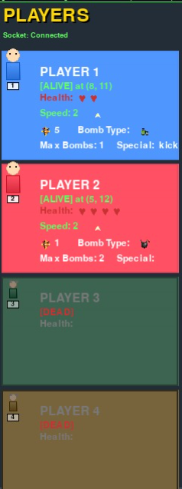
Game Statistics
The game keeps player statistics during the game.
Those are the statistics of each player that are displayed on left side of the screen:
Life – The remaining life of the player
Bombs – The amount of bombs that can be placed at the same time
Radius – The radius of the bomb explosion
Abilities – The power-ups the player have

Slide 6
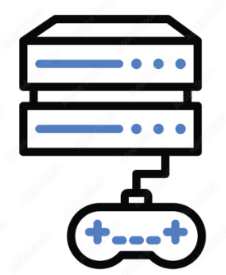
Node Types
The game has 2 types of nodes:
CN Sever (Central Node) – The safe node that manages the main communication and fault tolerance of the game
GN Server (Game Node) – The user node, in charge of a player and a quarter of the map
Estimated number of processes: 250 to 500+.

Slide 7
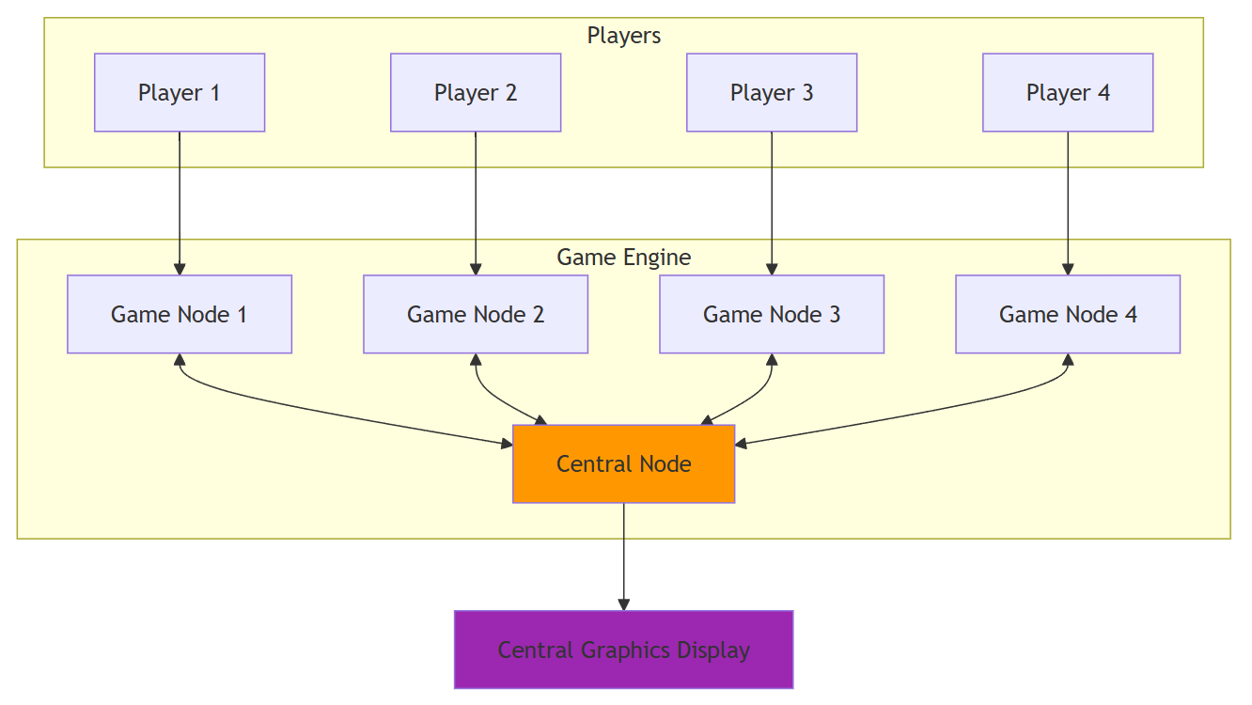
Game Architecture

Slide 8
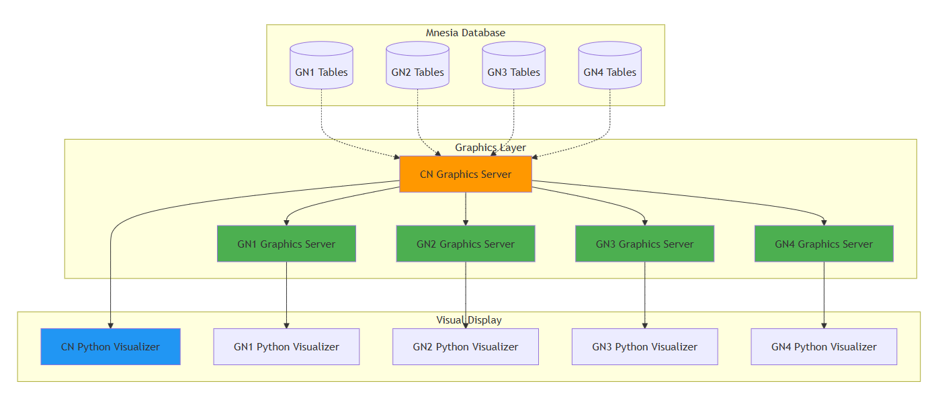
Graphics Logic

Slide 9
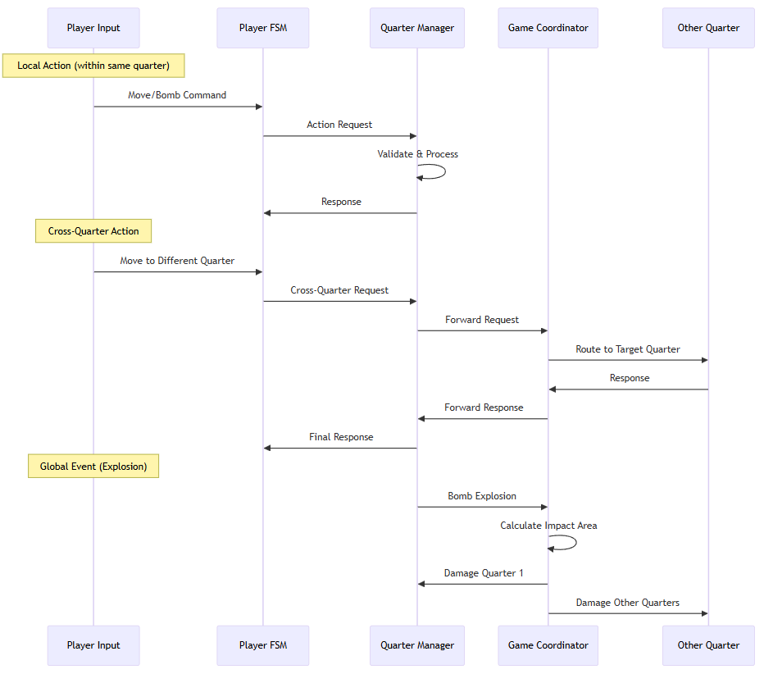
Message Flow

Slide 10
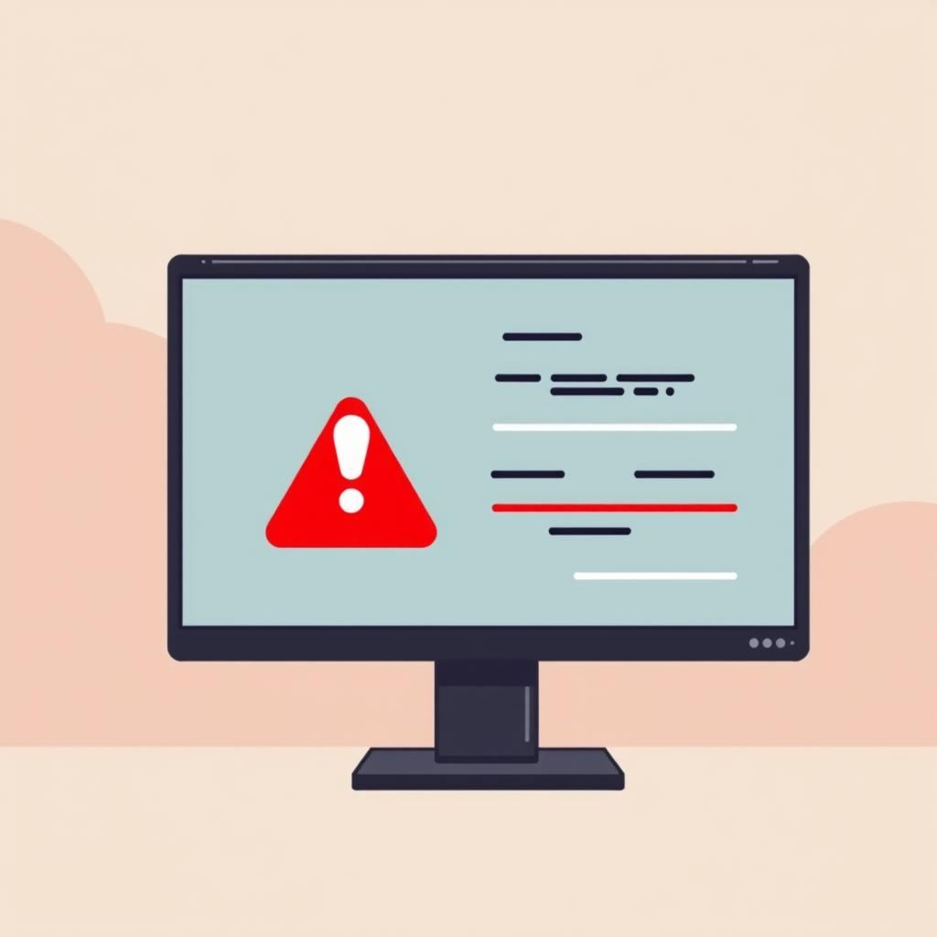
Fault Tolerance
Crash Detection:
CN monitors all GN processes.
If a GN PID dies → trigger recovery.

Slide 11

Fault Tolerance
Node Selection :
CN picks new host node with least load (load balance).
Ensures fair distribution of GNs.

Slide 12

Fault Tolerance
Recovery Steps:
CN Distributes crashed GN's mnesia tables to new host
GN initializes in recovery mode, replicating the GNs responsibilities based on stored game-state
GN updates all new PIDS of processes in mnesia tables (tiles, bombs, players, power-ups)
CN updates GN PID references

